Slide 1
Presence of Opiates in Wastewater
Drew Gobbi and Maddie Warndorf

Slide 2
The Question
Can the detected presence of opiates in wastewater from cities explain opioid related deaths?
This project will study the concentration of opiates in urban watersheds to estimate usage patterns in cities.
We will overlay these indicators of opioid use with demographic, geographic, and public health data to create a better understanding of the gaps in access to care.
Our aim is for public health professionals to use the results of this analysis to more efficiently divert resources and improve accessibility of treatment.

Slide 3
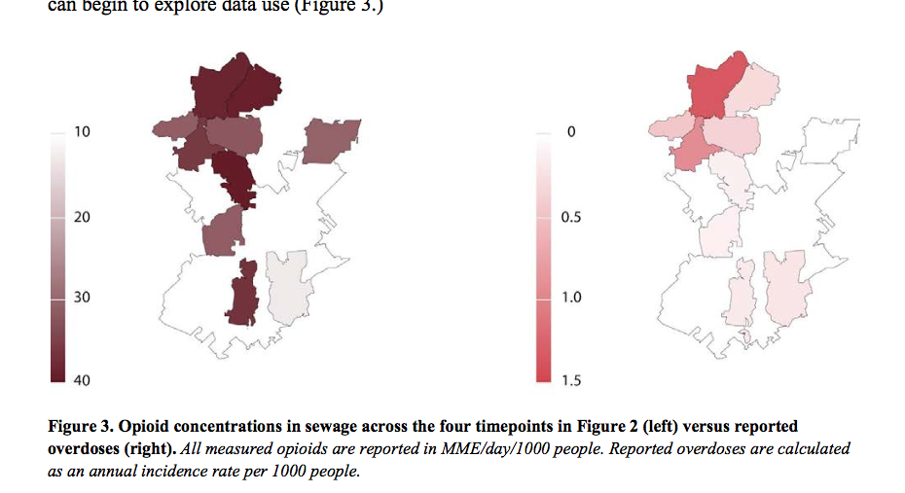
Motivating Factor
Traditional public health measures may not be showing the whole picture when it comes to opiate use
Analysis from Town of Cary, NC. Presentation at WEF Collection Systems Conference 2019. https://www.townofcary.org/projects-initiatives/project-updates/wastewater-projects/opioid-wastewater-monitoring

Slide 4
The Data
We have identified two candidate datasets that are currently testing opiate levels in wastewater pilots testing for opioids in the US right now
Tempe, AZ
Led by Arizona State University
Published in monthly dashboard w/ robust write up of methodology
Data collected from July 2018 -
Washington DC/Potomac Watershed
Led by a Mason grad student, publicly available but have requested access
Several important features such as frequency, geography, candidate drugs are unknown
Washington DC/ Potomac Watershed and we believe that two of them – one in Tempe, Arizona

Slide 5
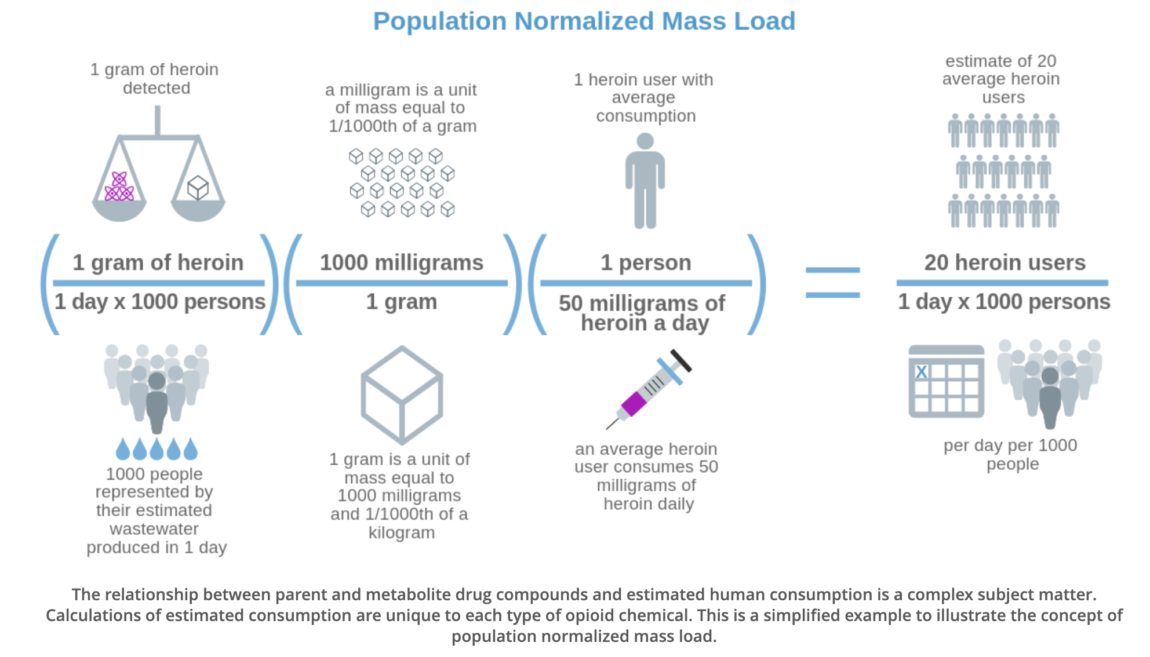
The Variables
Good estimator of overall use in an area because it is naturally anonymized in the city’s sewage system and representative of consumption patterns.
These data are likely to be unbiased because they do not rely on individual detection or self-reporting methods, where users have an incentive to understate their activity.
Data is noisy due to cross watershed flows
Photo taken from the City of Tempe and Arizona State University Partner to Study City Wastewater for Public Health Information’s Fighting Opioid Misuse by Monitoring Community Health website. https://www.arcgis.com/apps/Cascade/index.html?appid=92073d7f6a6a498b987f2afdab1b9471

Slide 6
The Plan
We will compare opioid normalized mass load measures with the number of opioid related incidents reported and treatment available in a given area
If, when, and where these three outcomes converge and diverge will be the key focus of this analysis.
Will tie these measures to demographic and geographic overlays to examine which communities are most impacted
Goal: Spatial Analysis of Opioid related incidents within the locality of interest

Slide 7
The Analysis
We remain algorithmically agnostic at this point in time
View this analysis as a spatial problem and see potential for both supervised and unsupervised learning (classification/clustering)
Will control for potential confounding relationships also found at the community level by controlling for:
Demographics
Geographic proximity to hospitals/treatment centers in a given area
Economic status
A limitation of this study is the fact that estimates represent entire communities. Some key features may be over/under-stated in the averaged out effects

Slide 8
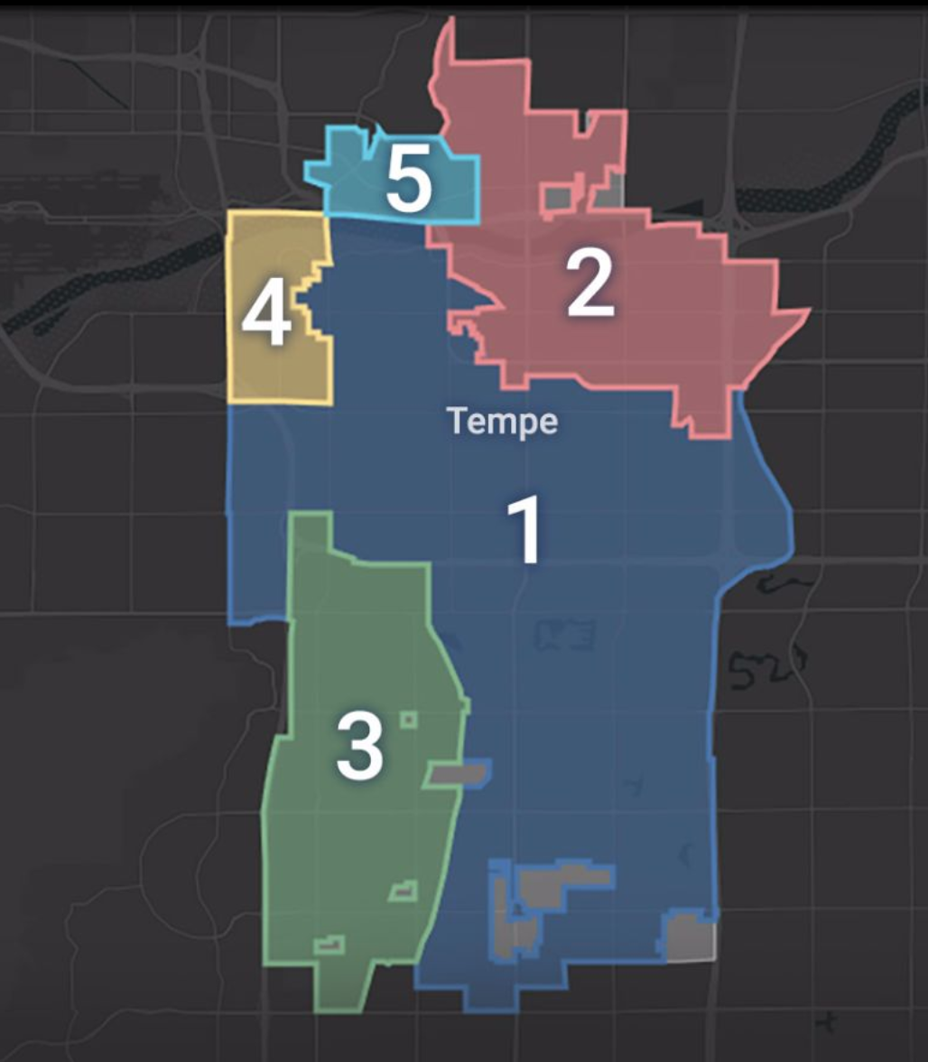
The Final Product
Our primary output will be a relational map of usage, access to care and current health outcomes that can be used by health administrators to identify vulnerable populations and improve access to care.
Photo taken from the City of Tempe and Arizona State University Partner to Study City Wastewater for Public Health Information’s Fighting Opioid Misuse by Monitoring Community Health website. https://www.arcgis.com/apps/Cascade/index.html?appid=92073d7f6a6a498b987f2afdab1b9471

